Slide 1
CSE 6324 Advanced Topics in Software Engineering
By Team 8:
SAI NIKHIL KANCHUKATLA(1002034488)
SAMPATH KUMAR MEDIPUDI(1002032901)
SAI KRISHNAM RAJU BHUPATHIRAJU(1002019782)
FARAZ SHAIK AHMAR(1002035224)

Slide 2
Outline
Project Plan
Issue and code
Pseudo Code
Risks and solutions
Customer and Users
References

Slide 3
Project plan
Iterations | Goals | Achieved Goals
1 | To gain a deeper understanding of the slither tool, we perform analysis on example smart contracts, providing a practical experience and familiarization with the tool. Set up and configure the slither tool in order to reproduce an identical error message. Evaluate the issue more comprehensively and devise a plan to address and resolve it. | completed
2 | Examine the "missing-zero-check" detector, comprehend all its attributes, and grasp its operational flow. Develop pseudo code that will facilitate the implementation of the improvements we aim to introduce to the slither tool. | completed
3 | Translate the pseudo code into real code and evaluate the tool to determine if any new vulnerabilities arise after modifying the existing tool. Verify the effectiveness of the improvements made to the tool by testing it on smart contracts. | In progress

Slide 4
Issue #981: Lack of checks by missing-zero-check detector in parent contract's constructor[8]
“missing-zero-check” detector doesn't seem to check the arguments for constructor of parent contracts.
Even if the parent contract's constructor has zero-access checks & the child contract is using the same variable, it's gets flagged. [8]
Copy-paste from github[8]

Slide 5
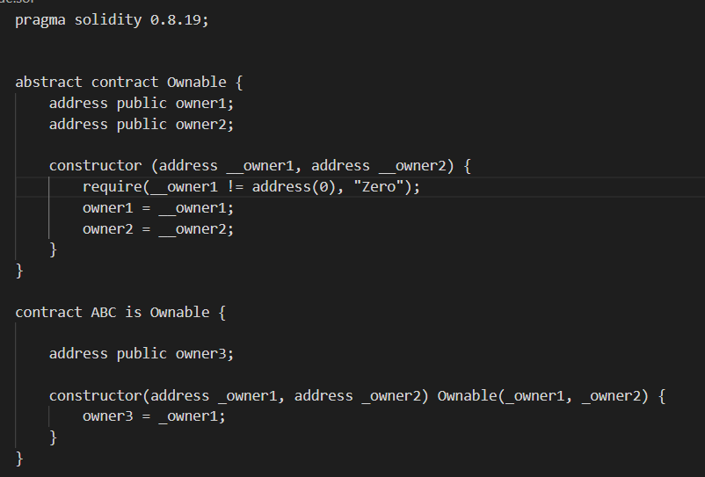
Code:
Figure [https://github.com/crytic/slither/issues/981]

Slide 6
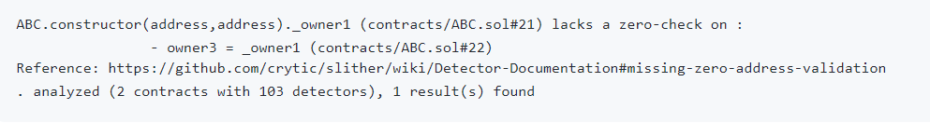
Output
Figure [https://github.com/crytic/slither/issues/981]

Slide 7
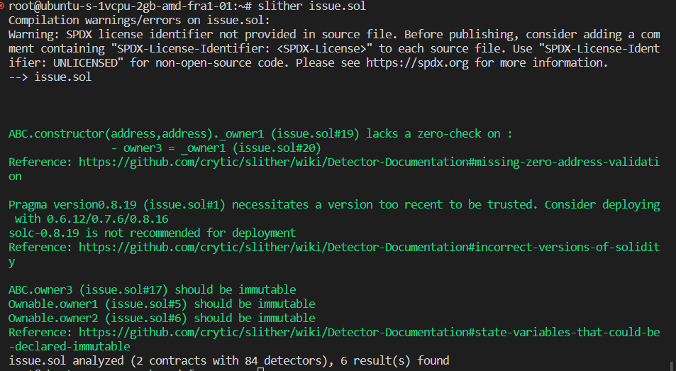

Slide 8
Enhancing Missing Zero-Check Detector to Include Inheritance Hierarchy[15]
Missing zero-check detector, as originally implemented, does not consider the inheritance hierarchy and checks for zero-address validation only within the context of the current contract.
By considering the inheritance hierarchy, the implementation will avoid flagging issues in child contracts when the zero-address validation is already handled in a parent contract's constructor
Considering inheritance hierarchy streamlines the code analysis, reducing false positives and enhancing the overall efficiency of the zero-address validation detector.

Slide 9
Pseudo CODE
Define a helper function check_parent_constructors(variable, child_constructor):
a. For each parent in child_constructor's inheritance chain: i. If the parent has a constructor:
1. Check if the zero-address validation is performed for the given variable in the parent constructor.
2. If the validation is found, return True.
b. Return False if no validation is found in parent constructors.

Slide 10
Pseudo CODE
Modify the analyze_function function: a. Inside the loop that checks local variables used in nodes: i. Before checking for zero-address validation in modifiers and function context, add a condition: 1. If check_parent_constructors(variable, function) is True, skip the current iteration.
Call the analyze_function for the constructor of the current contract and its parent contracts, as well as the functions entry points.

Slide 11
Risks AND SOLUTIONS
Risks | Major/Minor | Solution | Current Status
Installation of Slither (Configuration and setup) | Major risk P = 20% and E = 20 , so extra 4 hrs | For new users to reduce this risk, it's crucial that they thoroughly read the Slither team's documentation. | Completed
Unfamiliarity with the tool | Minor risk P = 30% and E = 10, so extra 3 hrs | It's crucial for new users to read the material given by the Slither team in order to lower this risk and watch the handson videos on youtube. | Completed
Installation of dependencies(Python) | Minor risk P = 15% and E = 10, so extra 1.5 hrs | Users face difficult in setting up compatable version of python to run slither. | Completed

Slide 12
Risks AND SOLUTIONS
Risks | Major/Minor | Solution | Current Status
Prioritizing the vulnerabilities | Major risk P = 35% and E = 14 , so extra 3.5 hrs | It's encouraging to see that the objectives stated for each project iteration look doable. Knowing that the team has added extra hours to accommodate for potential risks is also encouraging. | In progress
structure of Slither tool of each domain | Major risk P = 25% and E = 15, so extra 5 hrs | We focus on the smart contract design that is most frequently used in the finance industry. | In progress

Slide 13
Customer and Users
Block chain Developers ,Blockchain organizations ,Researchers ,Security Researchers
Customer /User | Feedback | Comments
Egan Lobo(Solidity Beginner) | The issues were clearly understood by the team. | It's encouraging to see that the objectives stated for each project iteration look doable. Knowing that the team has added extra hours to accommodate for potential risks is also encouraging.
Sallagonda, Avinash (Current Developer in Ethereum) | The smart contract that was employed was simple and straightforward. | He provided advice on how to build a feature and provided an approach for one of the project's features, which helped.

Slide 14
Github link
https://github.com/Sampath2901/6324-Project#6324-project

Slide 15

References
[1] https://www.visual-paradigm.com/guide/uml-unified-modeling-language/what-is-use-case-diagram/ [04/03/2023]
[2] https://doi.org/10.48550/arXiv.1908.09878 [04/03/2023]
[3] https://doi.org/10.48550/arXiv.1809.02702 [04/03/2023]
[4] https://github.com/crytic/slither [04/03/2023]
[5] https://blog.trailofbits.com/2018/10/19/slither-a-solidity-static-analysis-framework/ [04/03/2023]
[6] https://medium.com/coinmonks/automated-smart-contract-security-review-with-slither-1834e9613b01 [04/03/2023]
[7] https://www.linkedin.com/pulse/how-secure-smart-contracts-slither-damilare-d-fagbemi/?trk=pulse-article_more-articles_related-content-card [04/03/2023]
[8] https://github.com/crytic/slither/issues/981 [04/03/2023]
[9] https://app.diagrams.net/ [04/03/2023]

Slide 16
References
[10] https://www.h-x.technology/blog/top-3-smart-contract-audit-tools [04/03/2023]
[11] https://doi.org/10.48550/arXiv.1908.09878 [04/03/2023]
[12] https://doi.org/10.48550/arXiv.1809.02702 [04/03/2023]
[13] https://blog.trailofbits.com/2019/05/27/slither-the-leading-static-analyzer-for-smart-contracts/ [04/03/2023]
[14] https://github.com/crytic/slither#features [04/03/2023]
[15] https://www.sciencedirect.com/topics/computer-science/inheritance-hierarchy [04/03/2023]

Slide 17

Thank You

